Slide 1





Slide 2

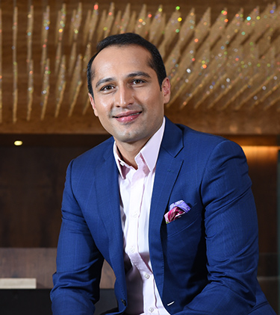
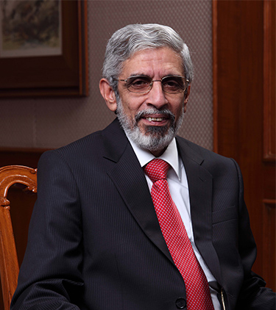
RAVI PURAVANKARA
Founder & Chairman
ASHISH PURAVANKARA
Managing Director
NANI R CHOKSEY
Vice-Chairman
Puravankara Limited is one of India's leading listed real estate companies headquartered in Bengaluru. The company embarked on its remarkable journey 47 years back in 1975 with a clear vision and mission to meet the aspiration of teeming millions by offering quality homes.
Over the years, brand Puravankara has grown from strength to strength and has completed close to 43 million square feet and 74 projects (both Puravankara and Provident).
Puravankara has a presence across India - Bengaluru, Hyderabad, Chennai, Kochi, Coimbatore, Mangaluru, Kolkata, Mumbai, Pune and Goa with an overseas presence in GCC and Sri Lanka
Puravankara limited, #130/1 Ulsoor Road Bengaluru 560 042

Slide 3





GROUP COMPANIES
Provident Housing Limited, a 100% subsidiary of Puravankara Ltd launched in the year 2008 to meet the aspirations of mid-income and first-time homeowners. Till date over 20 million square feet of projects have been launched out of which close to 10 million square feet have been completed and delivered to over 26,000 happy and satisfied homeowners. Additionally, over 8 million sq.ft. is planned for new launches in near future.
PROJECTS
BANGALORE | CHENNAI | PUNE | MUMBAI | K0CHI | COIMBATORE | HYDERABAD | GOA
Purva Land : A foundation to build your dreams upon
Purva Streaks, in-house home interior brand of Puravankara Limited, was conceptualized in the year 2007, with a vision of providing interior home
solutions to the customers of Puravankara.
Purva Land is a new venture by the Puravankara Group that aims to provide unique plotted communities across the country.
Propmart is one of India's premier Real Estate Services. Propmart aims to support
customers and developers by providing value added services, through online & offline
channels, and meet their requirements in new home purchase, rental & resale services etc.
Starworth Infrastructure and Construction Limited (SICL)

Slide 4

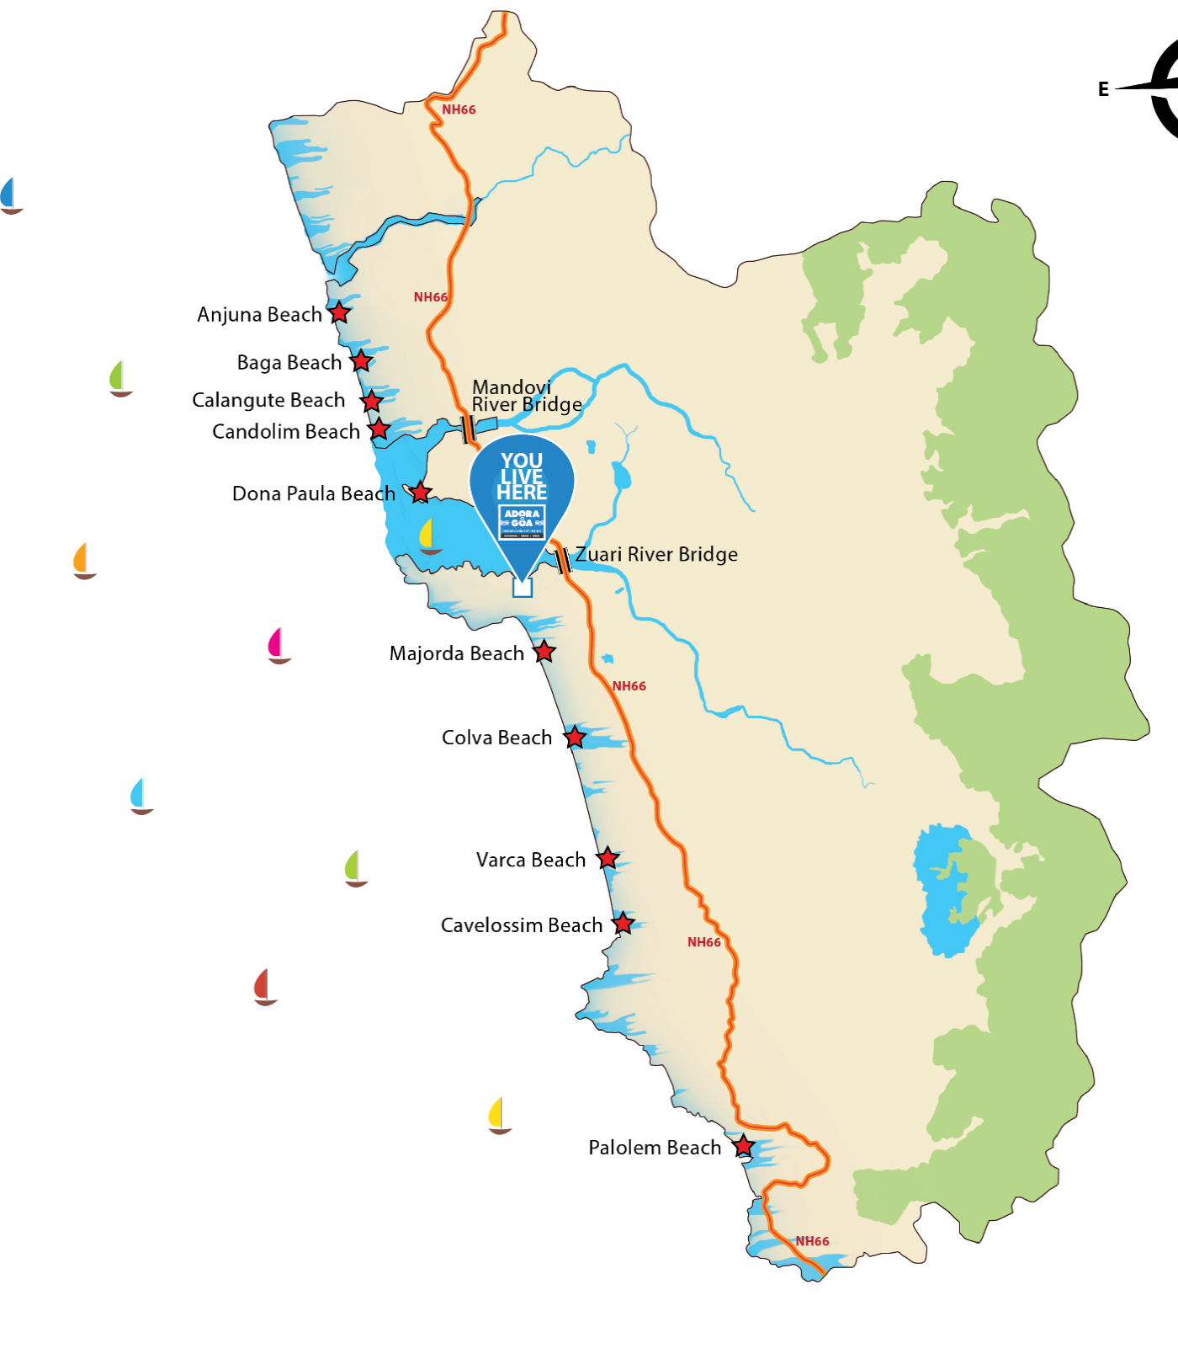

THE LOCATION
CENTRAL GOA
North Goa
ZUARI RIVER
ARABIAN SEA
South Goa

Slide 5
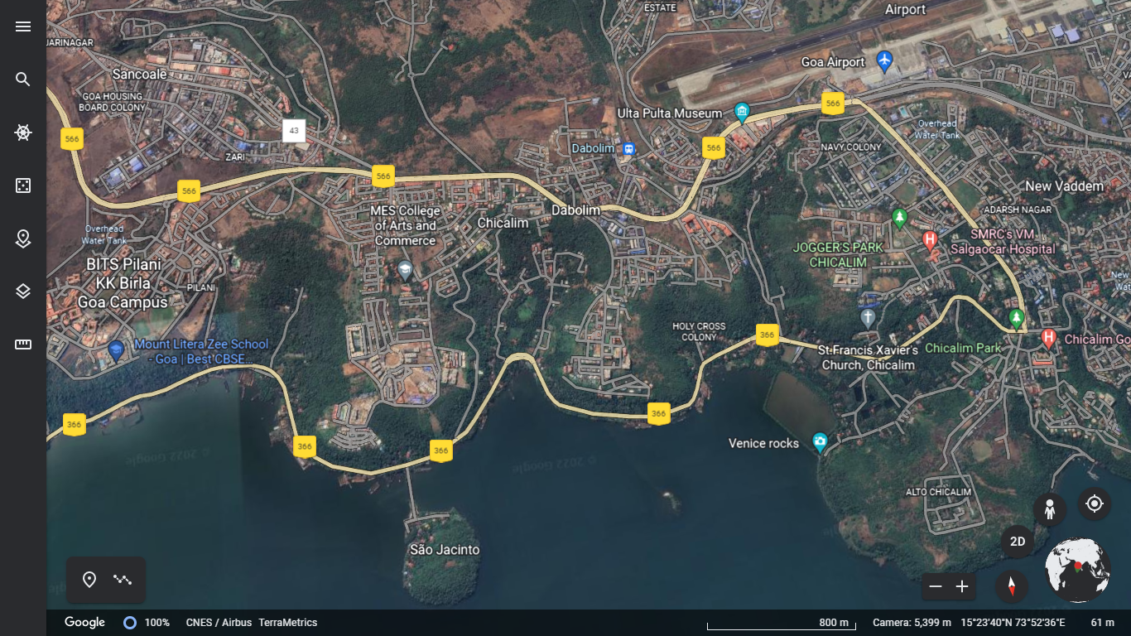

NH566
NH366

Slide 6
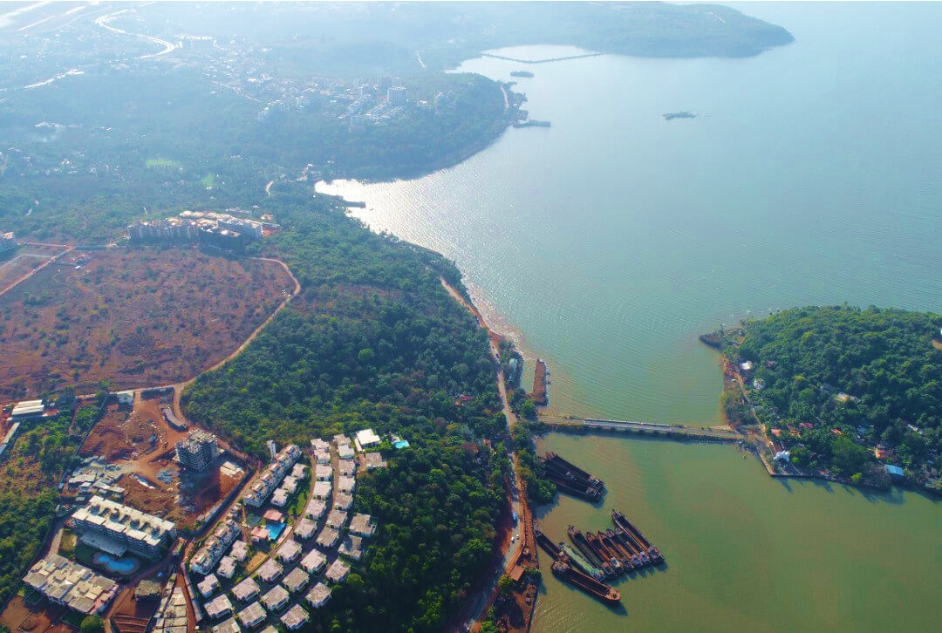

Slide 7
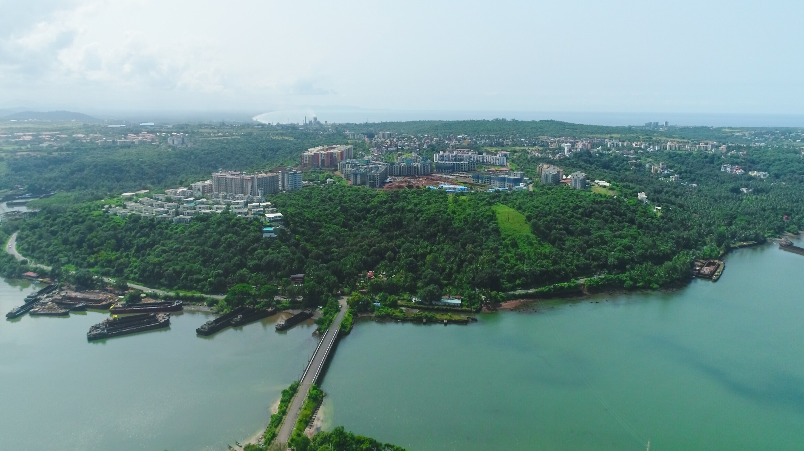

Slide 8
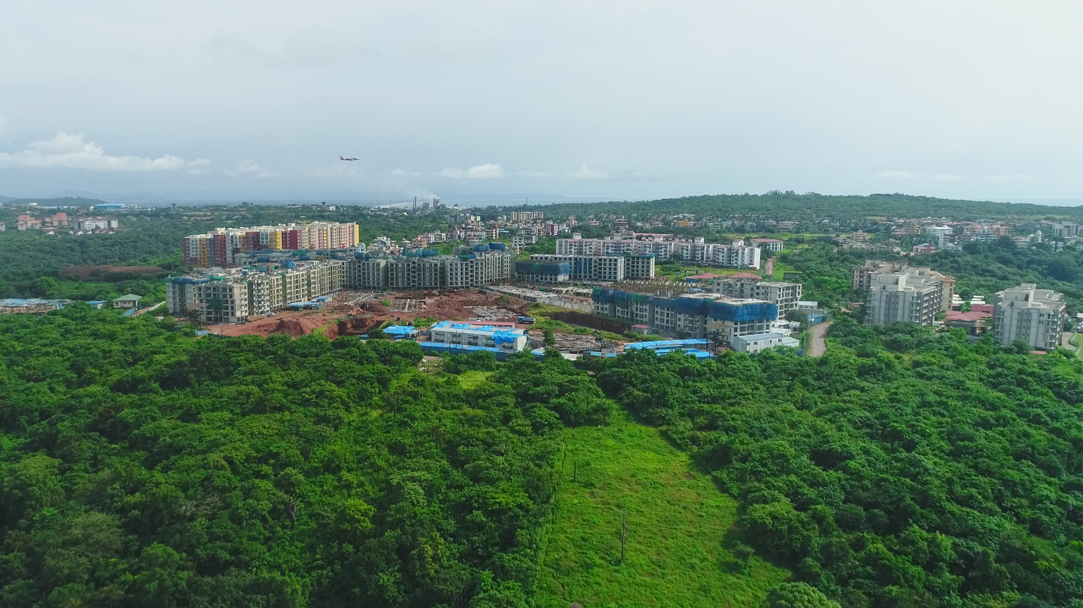
NATURAL RESERVE / ORCHARD

Slide 9
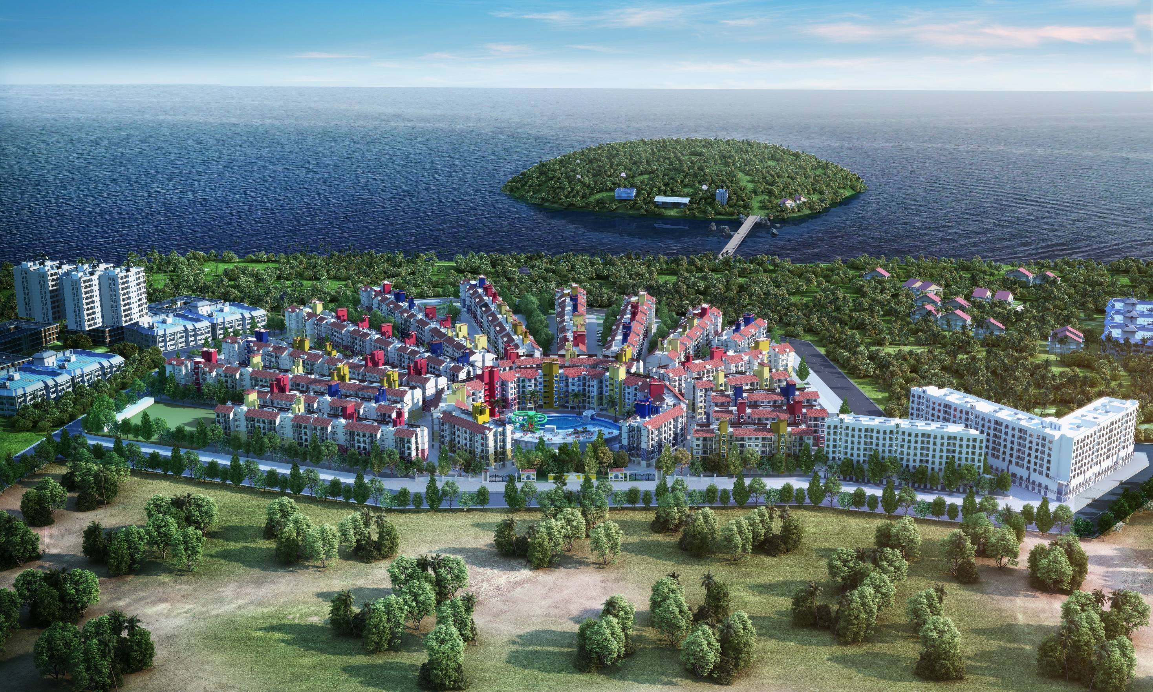


Slide 10
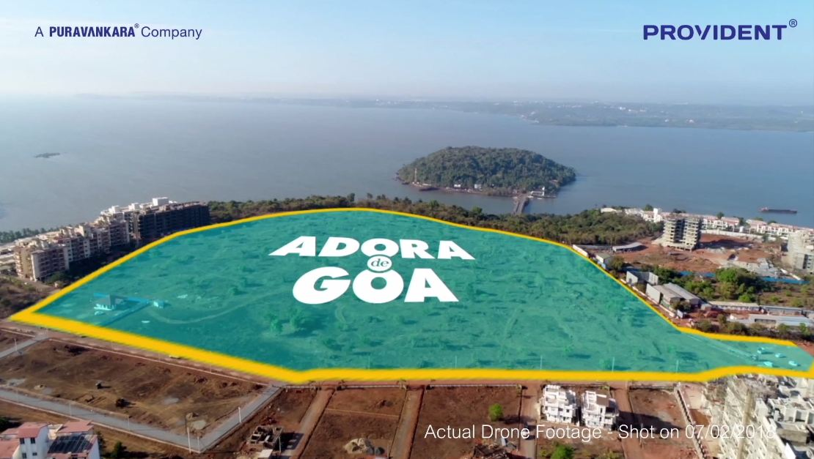
SAO JACINTO ISLAND
32 ACRES

Slide 11

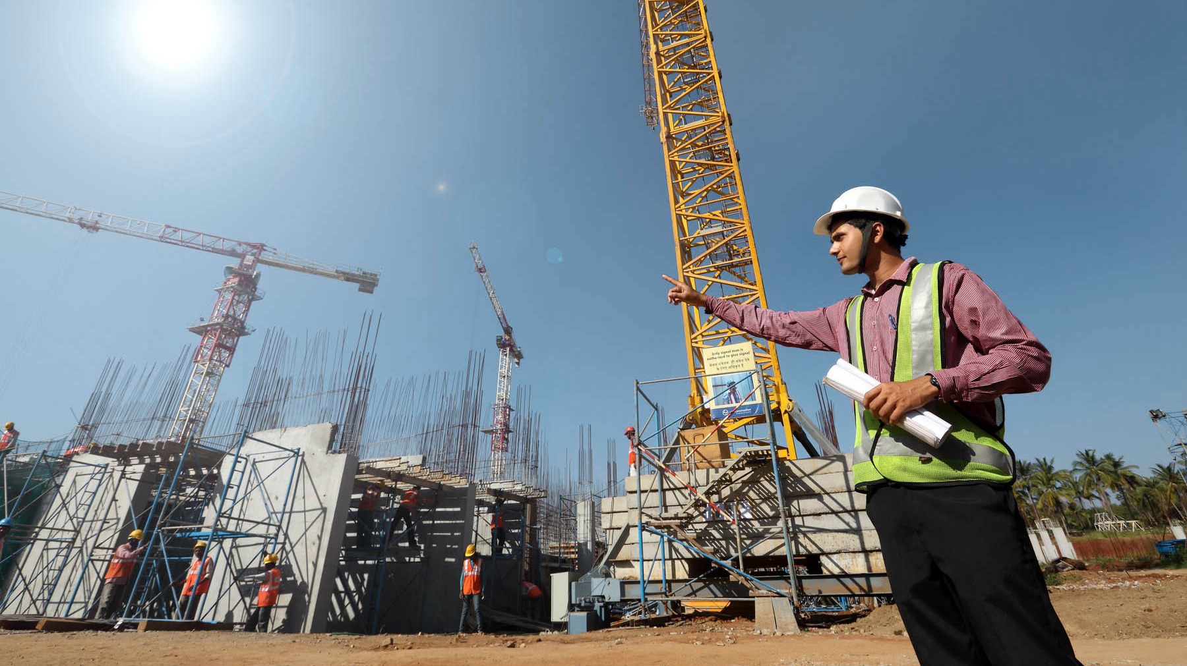

Slide 12

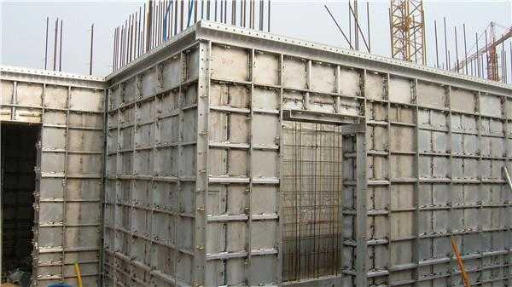
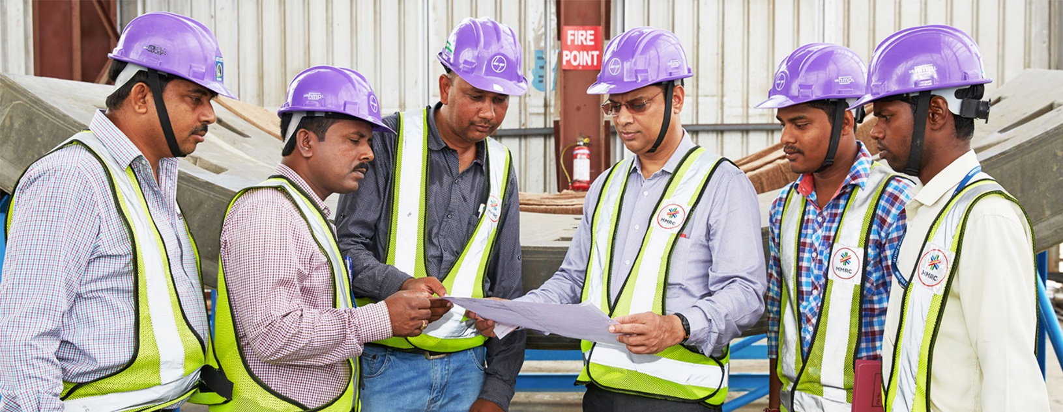
The New Age Construction
MIVAN
Aluminium Formwork Construction Technique
- Smooth Finish – Mivan construction ensures uniformity; hence all walls & slabs have a smooth finish which means additional plastering is not needed
- Earthquake Resistant
- Low maintenance
- Good quality construction work

Slide 13






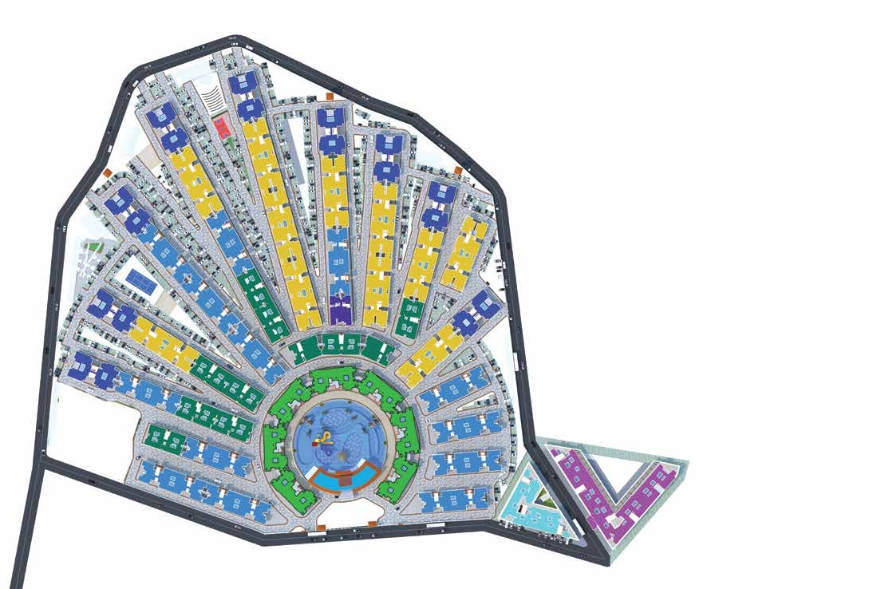



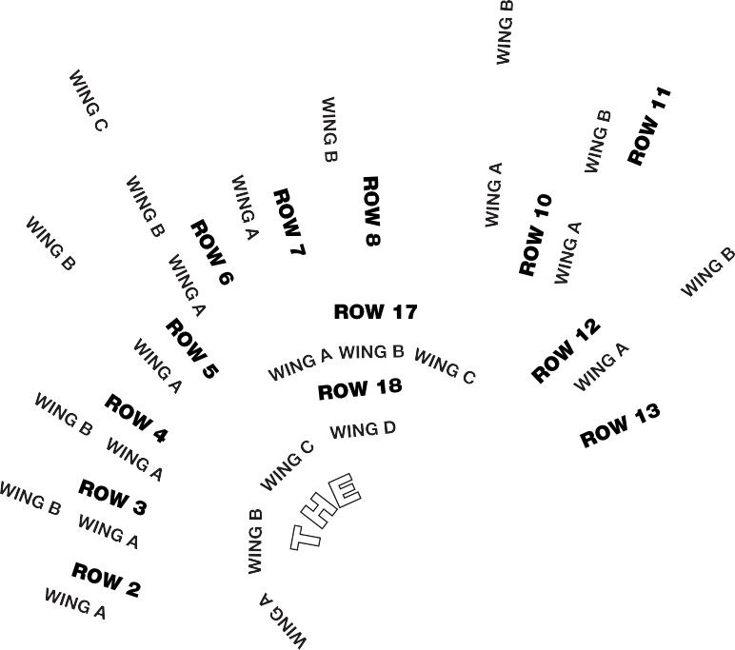







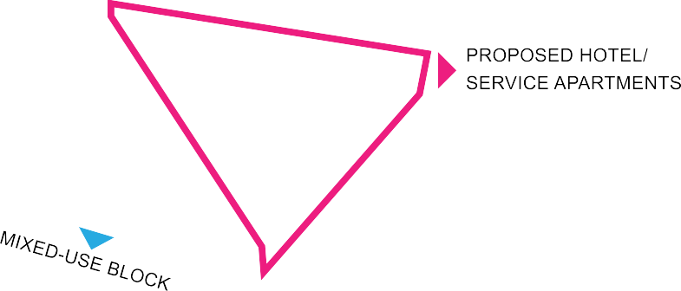



Slide 14
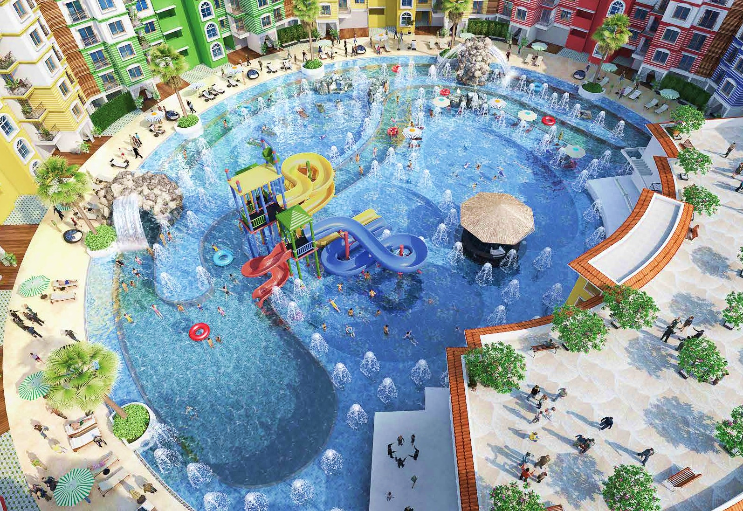




THE BLU
NEAR 1-ACRE WATER ZONE WITH:
Multiple Pools
Sunken Bar Jacuzzi Aqua Slides
Snorkeling Zone
Lazy River
Aqua Gym
Signature Drenching Fountain
NEAR 1-ACRE DRY LEISURE ZONE WITH:
Clubhouse
Poolside Restaurant Private Cabanas Decks around the Blu
Adora de Goa is a multi-phased development. Buildings, amenities and facilities will be developed in a phased manner. Master plan is an indicative digital rendering of all phases post completion

Slide 15
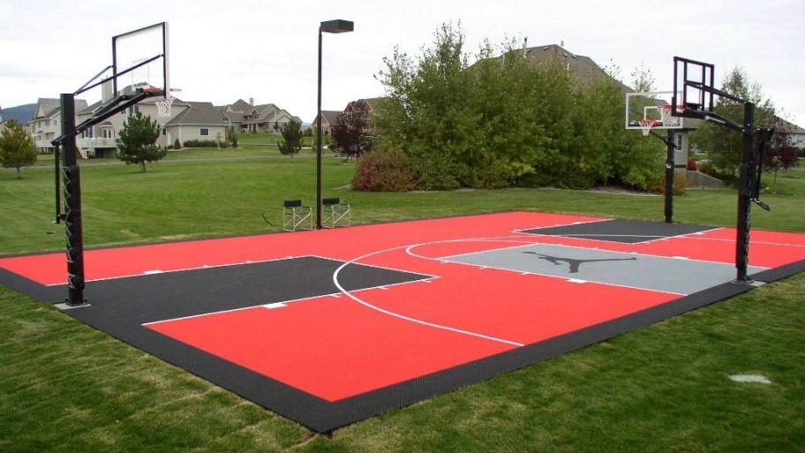

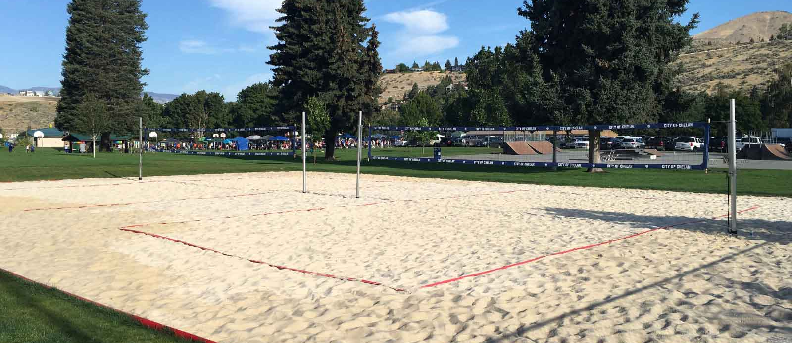

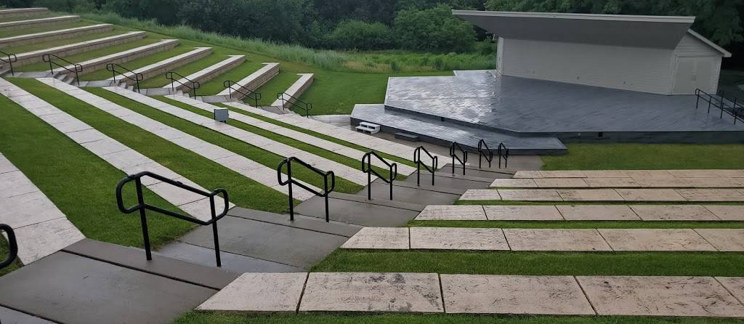
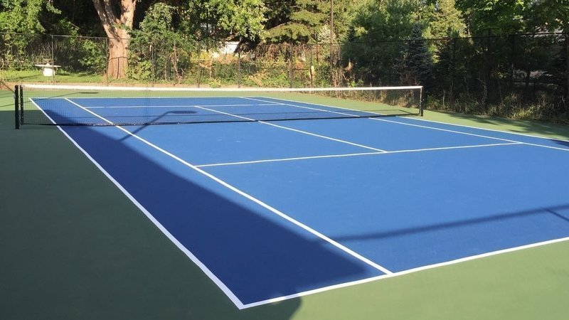
Homes With The Soul Of A Resort
BASKETBALL court
Multi-Sport Sand court
OPEN AIR BLUETOOH Amphitheatre
TENNIS court

Slide 16


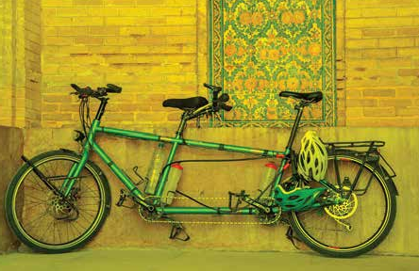
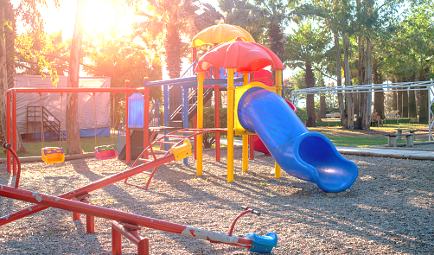


SKATING Area
TANDUM Bicycles
THE WALK
@ ADORA DE GOA
CHILDRENS play Area

Slide 17

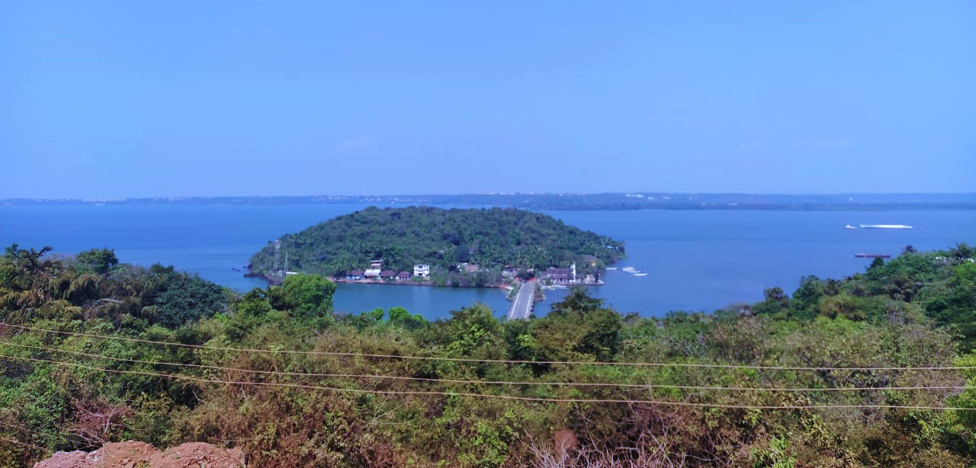
Observation Tower
'𝐀𝐃𝐎𝐑𝐀 𝐃𝐄 𝐆𝐎𝐀'

Slide 18
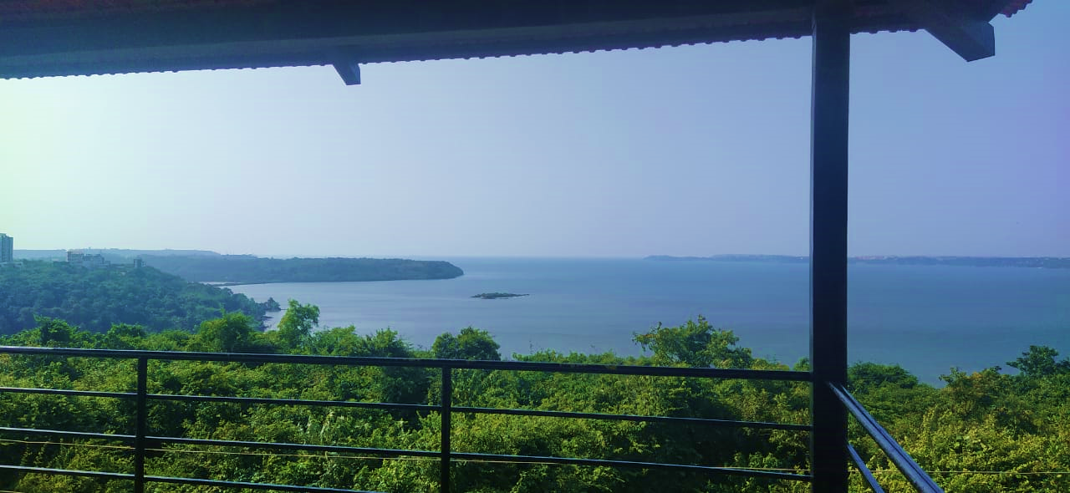
Observation Tower
'𝐀𝐃𝐎𝐑𝐀 𝐃𝐄 𝐆𝐎𝐀'

Slide 19






The entire elevation and landscape of Adora de Goa stems from the
idea of fusion. At Adora de Goa you’ll find the true spirit of Goa, that’s vintage yet modern in
outlook. The bright coloured
facade, the Piazza, Baroque statues, hand painted tiles and such other
thoughtful fixtures will evoke the
grandeur of bygone Portuguese era, while the ultra-modern amenities, precisely finished interiors and
fixtures like rain shower in the
en-suite bathroom and digital locks at the entrance are a reflection of modern living.
GOAN OUTSIDE
MODERN INSIDE
Portuguese Styled Canopy
Portuguese Styled Window
Hand-Painted Door Number Plates
Goan-Style Balcony Railing
Baroque Statue

Slide 20













‘Never give safety
‘Transform your world.’
- Kajaria
‘Paint your imagination.’
- Berger Paints
‘switch to style.’
- Schneider Electric
a day off.’
- YALE
your MAIN Door Lock
Yale, a 178-year old legendary brand from Europe is amongst the best known names in the lock industry, with millions of Yale locks used across 125 countries worldwide.
Your living and bedroom tiles
Kajaria Ceramics is the largest manufacturer of Ceramic/Vitrified tiles in India. Founded three decades ago, Kajaria has since become synonymous with quality, service and innovation, not only in the domestic market but worldwide too.
your exquisite wall paint
Berger Paints is a 258-year old iconic brand with Anglo-Indian roots. A true Indian MNC today, it’s one of the most trusted paint brands in the world.
Your electrical switches
Schneider Electric is a $ 25 billion global conglomerate with a 180-year legacy, and is a global specialist in Energy Management and Automation.
Brands that matter are within your home

Slide 21
PROJECT ENTRANCE / EXIT GATES
NORTH ENTRANCE
WESTERN ENTRANCE
EASTERN ENTRANCE
MAIN ENTRANCE

Slide 22
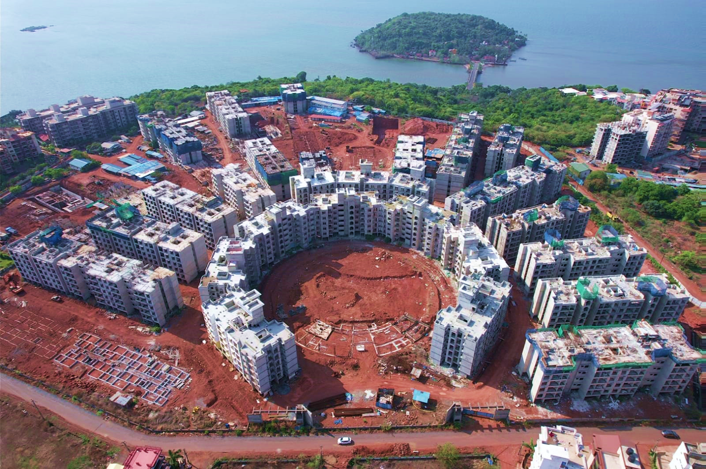

View
7
8
9
10
11
6
5
17
4
12
3
18
13
2
14
15
1
16

Slide 23










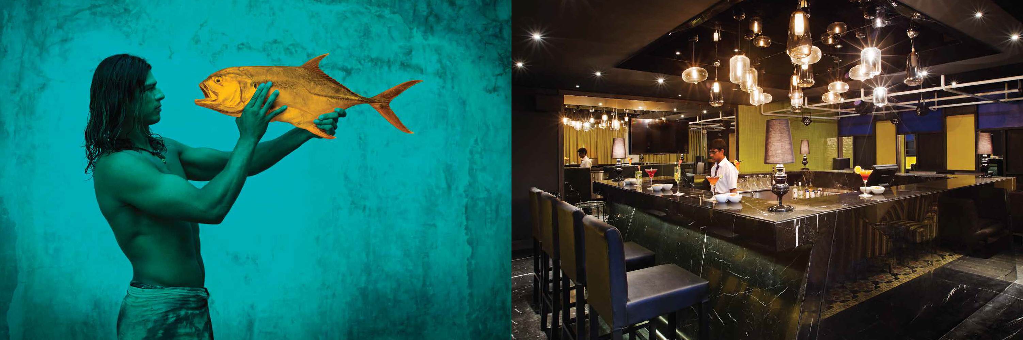



Park Residences
Around The Blu
EAST POINTE
1, 2 & 3 BHK HOMES
HOMES
Branded Luxury Residences & Lifestyle Homes.
RESORT*
Hotel Service Apartment operated by ‘Zone by The Park’.
SHOPPING
High-Street Coffee Shop, Restaurants, Spa & Boutique Shopping.
5 - RESIDENCES

Slide 24
PHASES
PHASE 1
PHASE 2
PHASE 3
MARCH 2023
MARCH 2024
DEC 2025
RERA REGISTRATION

Slide 25












EAST POINTE
PHASE - I
ROW : 10,11,12,13, 14 & 15
MARCH 2023
ROW: 10, 11, 12, 17 & 18
EAST
POINTE
EAST POINTE
1, 2 & 3 BHK HOMES
ROW : 10, 11 & 12
Park Residences
Around The Blu
ROW : 17 & 18

Slide 26
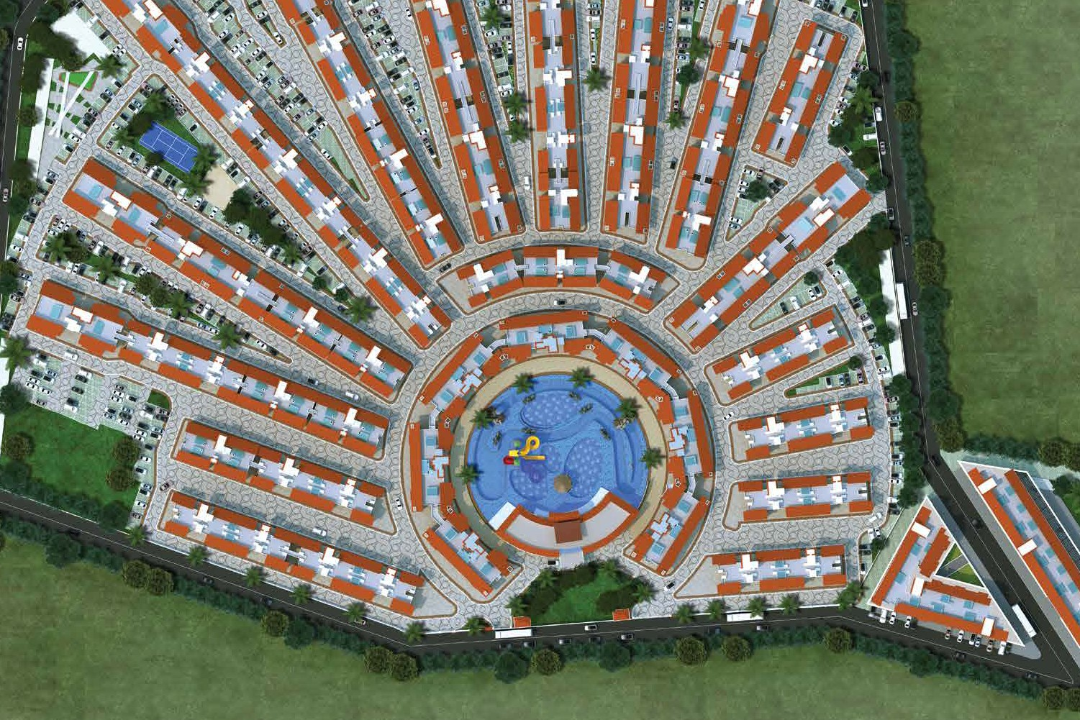
Room service cum subscription-based House Keeping services from onsite hotel/service apartments
Lifetime privileges on tariff for rooms / F & B discounts across The Park Hotels & Zone by The Park Hotels
Park Residences
Around The Blu
ROW : 16,17,18, 2,3 & Mixed Block
The Park Baga River Goa
The Park Calangute Goa
ROW NO 17.
ROW NO 18.
ROW NO 3.
SHOPPING
High-Street Coffee Shop, Restaurants, Spa & Boutique Shopping.
ROW NO 2.
ROW NO 16.

Slide 27



PHASE - II
MARCH 2024
ROW: 13, 14, 15, 16 & Mixed Block | 2,3,4,5 & 6
PHASE 2
Part - I
ROW : 5 & 6
EAST POINTE
1, 2 & 3 BHK HOMES
ROW : 4
ROW : 13, 14 & 15
Park Residences
Around The Blu
ROW : 2,3,16
& MB

Slide 28


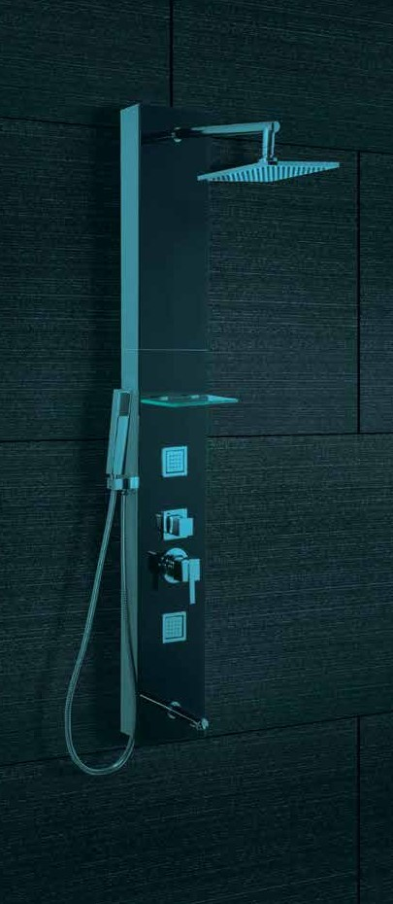



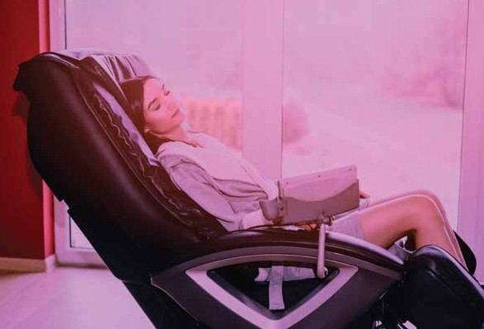
A FIVE
FIXTURE HOME SPA @ BALINESE RESIDENCES
Face Steamer
India’s first Spa Residences!
3-fixture shower panel
ROW : 5 & 6
OCT 2023
Neck to feet massage lounger
feet cleanser
Aromatic diffuser

Slide 29
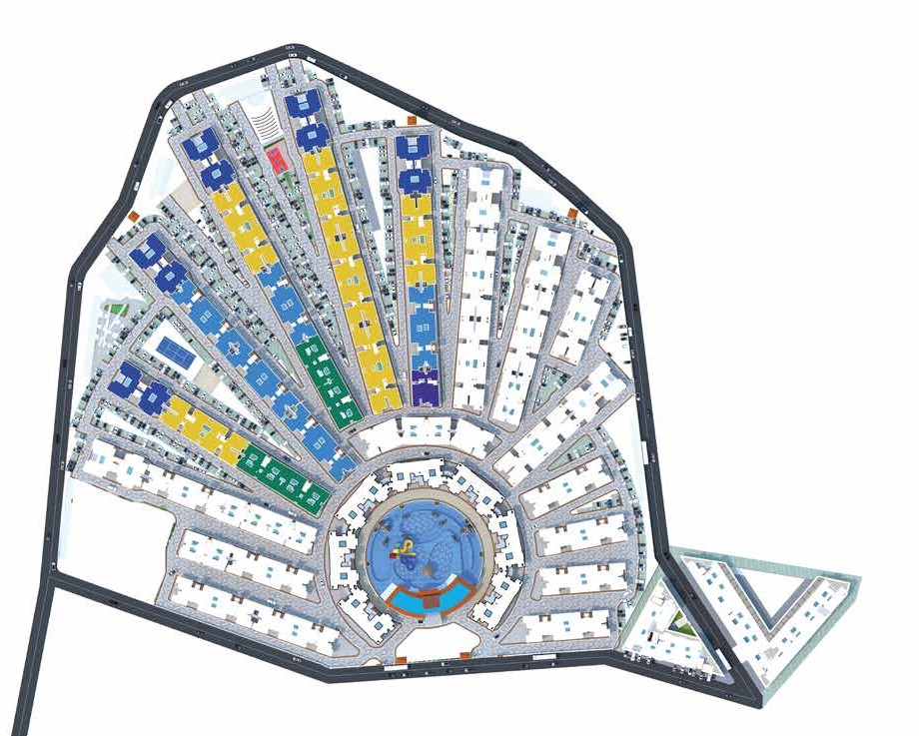

LAYOUT PLAN OF PHASES BEING LAUNCHED
PHASE – III
DECEMBER 2025
ROW: 7 & 8
ROW 7
ROW 6
D
ROW 8
E
D
C
ROW 5
D
C
D
B
SPA CONDO / 1BHK
C
C
SPA SUITE / 2BHK
B
COMBO BLOCK OF SPA SUITE / 2BHK
AND ROYAL SPA SUITES / 3BHK COMFORT
ROW 4
B
A
PRESIDENTIAL SPA SUITE / 3BHK GRAND
C
B
A
A
B
A
A
H
E
B
L
T
U
PROPOSED HOTEL/ SERVICE APARTMENTS
MIXED-USE BLOCK
Adora de Goa is a multi-phased development. Buildings, amenities and facilities will be developed in a phased manner. Master plan is an indicative
digital rendering of all phases post completion.

Slide 30
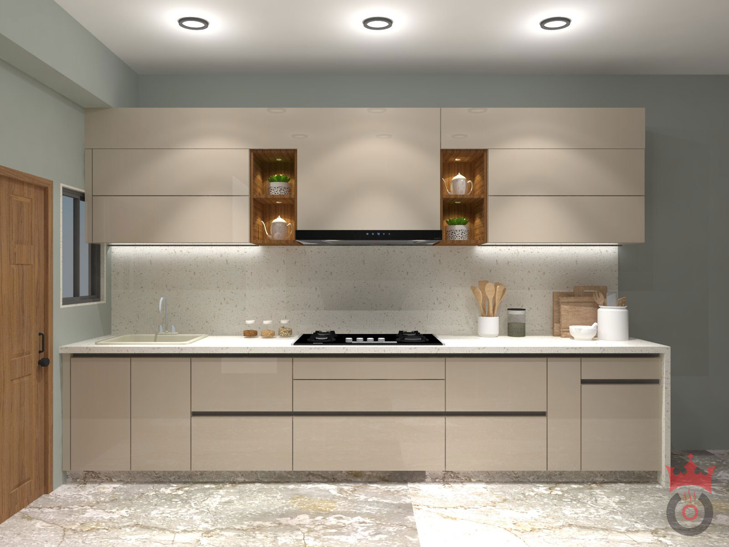


Slide 31
UNIT PLAN
1 BHK
2 BHK
3 BHK
COMFORT
3 BHK
GRAND

Slide 32
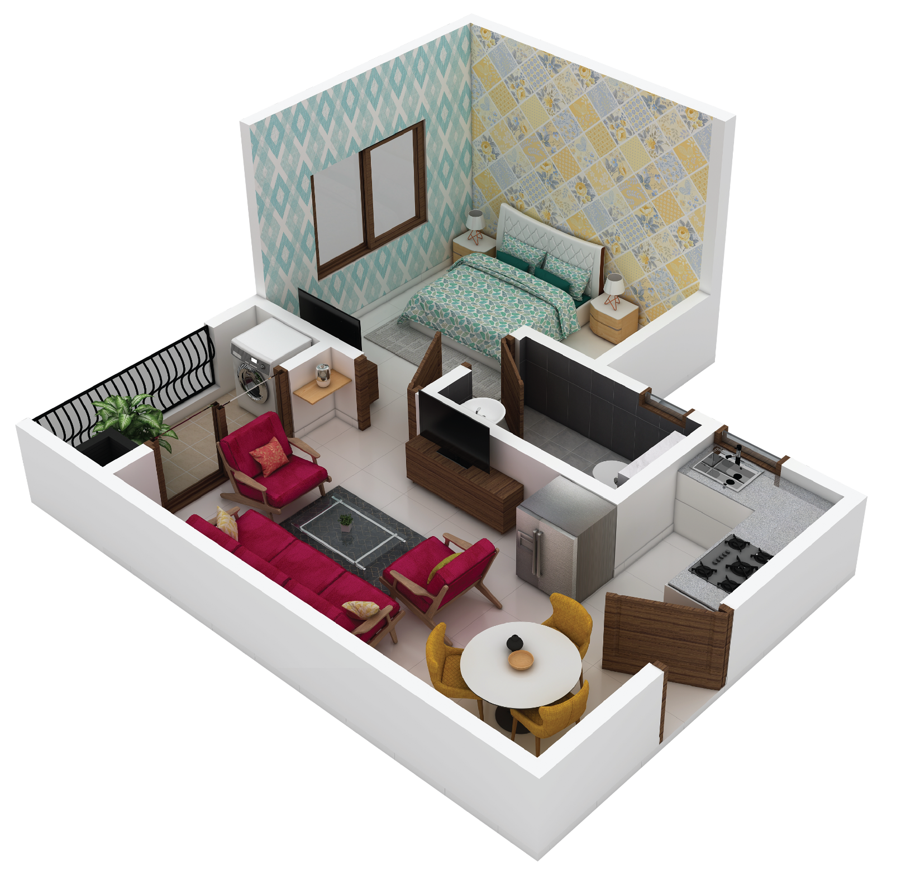
Typical Areas
Carpet Area | ~350 sq.ft.
Usable Area | ~385 sq.ft.
Saleable Area | ~540 sq.ft.
SPA CONDOS – 1 BHK
Typical Unit Plan

Slide 33
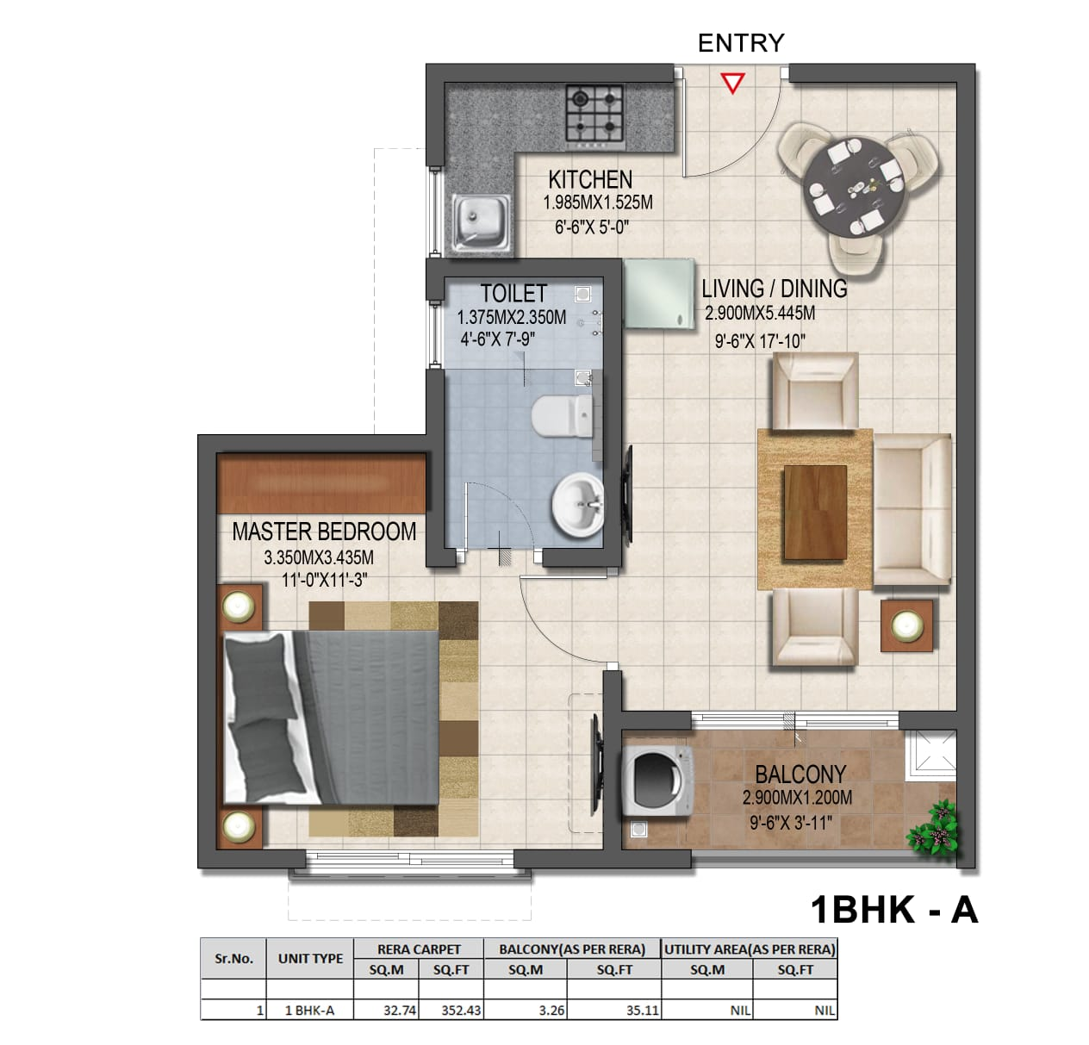

Slide 34
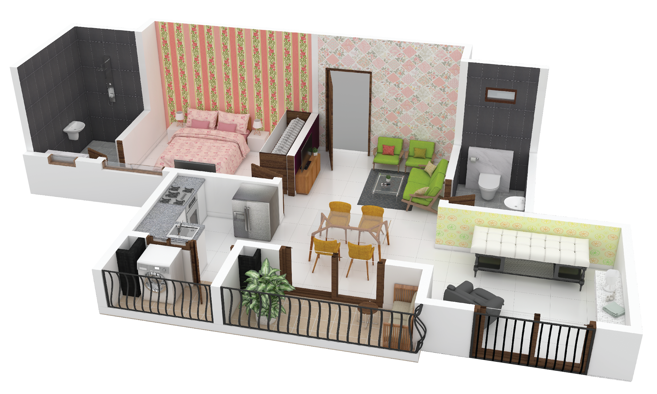
Typical Areas
Carpet Area | ~510 sq.ft.
Usable Area | ~570 sq.ft.
Saleable Area | ~810 sq.ft.
SPA SUITES – 2 BHK
Typical Unit Plan

Slide 35
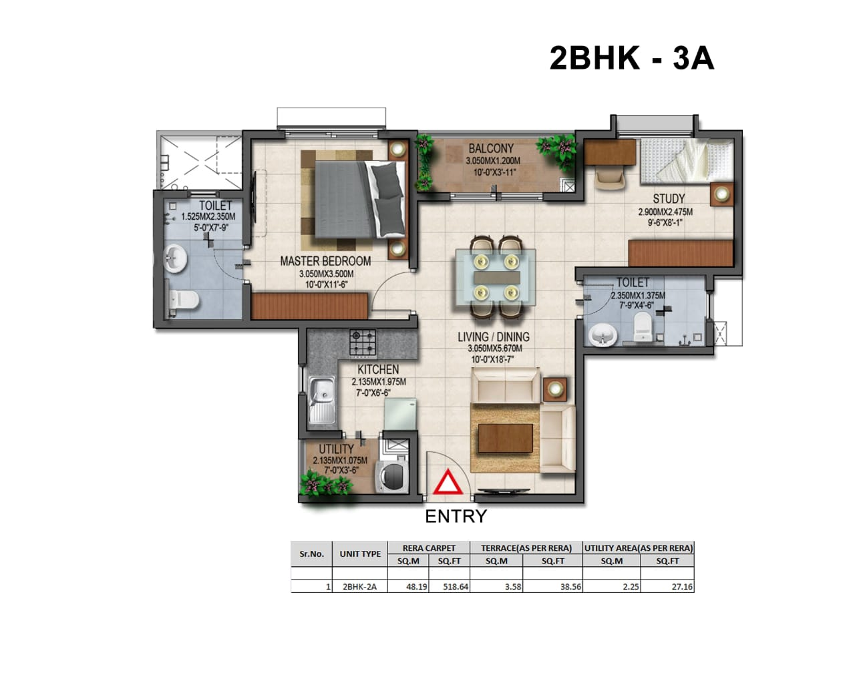

Slide 36
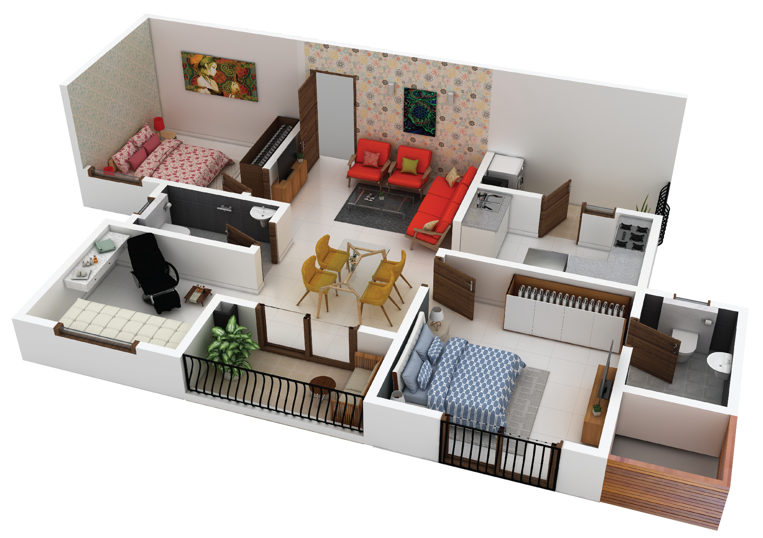
Typical Areas
Carpet Area | ~735 sq.ft.
Usable Area | ~830 sq.ft.
Saleable Area | ~1140 sq.ft.
ROYAL SPA SUITES – 3 BHK COMFORT
Typical Unit Plan

Slide 37
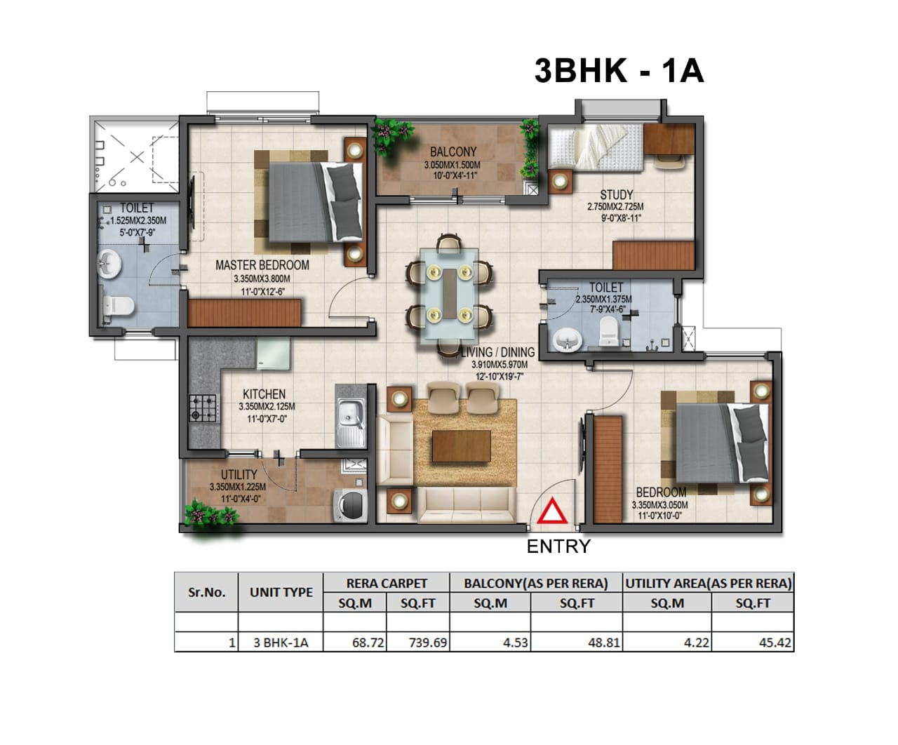

Slide 38
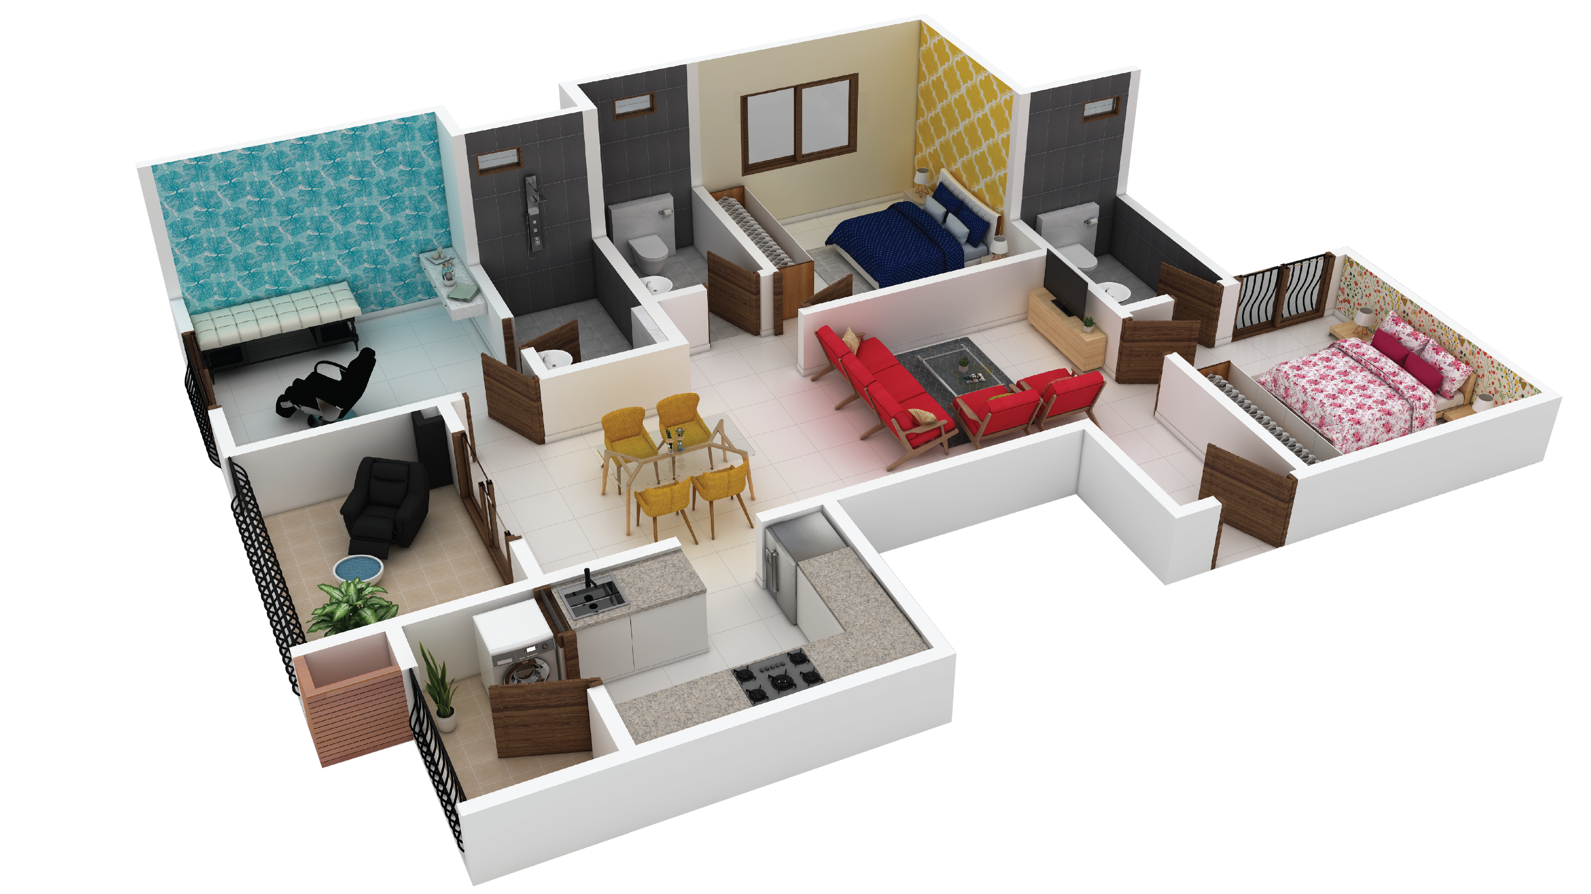
Typical Areas
Carpet Area | ~970 sqft.
Usable Area | ~1090 sqft.
Saleable Area | ~1500 sqft.
PRESIDENTIAL SPA SUITES – 3BHK GRAND
Typical Unit Plan

Slide 39
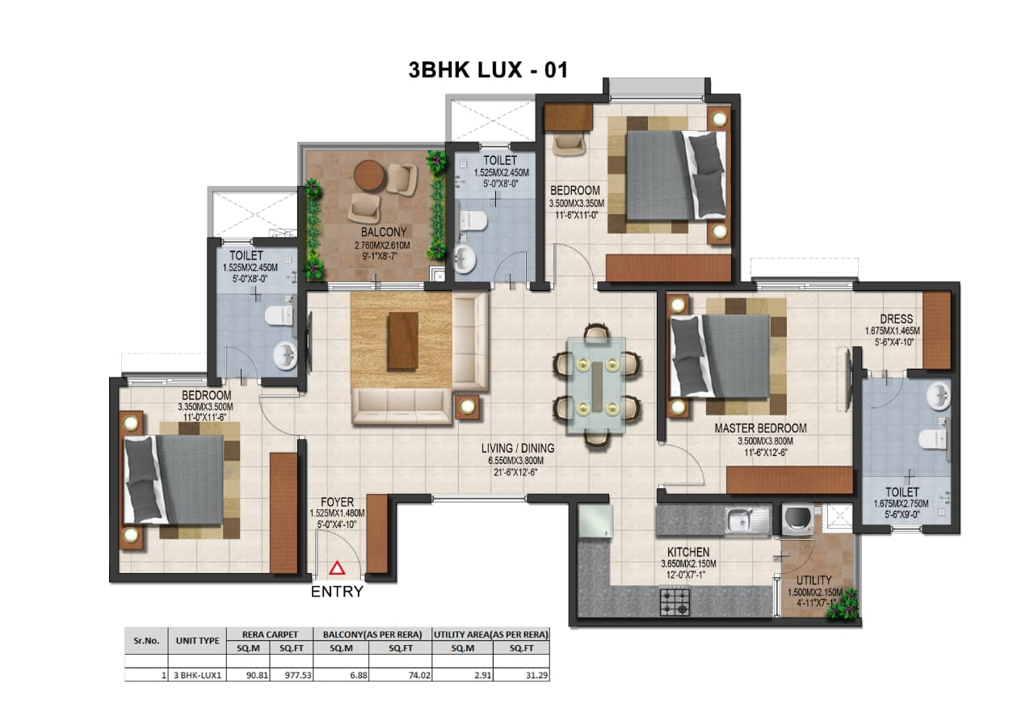

Slide 40


Holiday Home Rental Partner

Slide 41

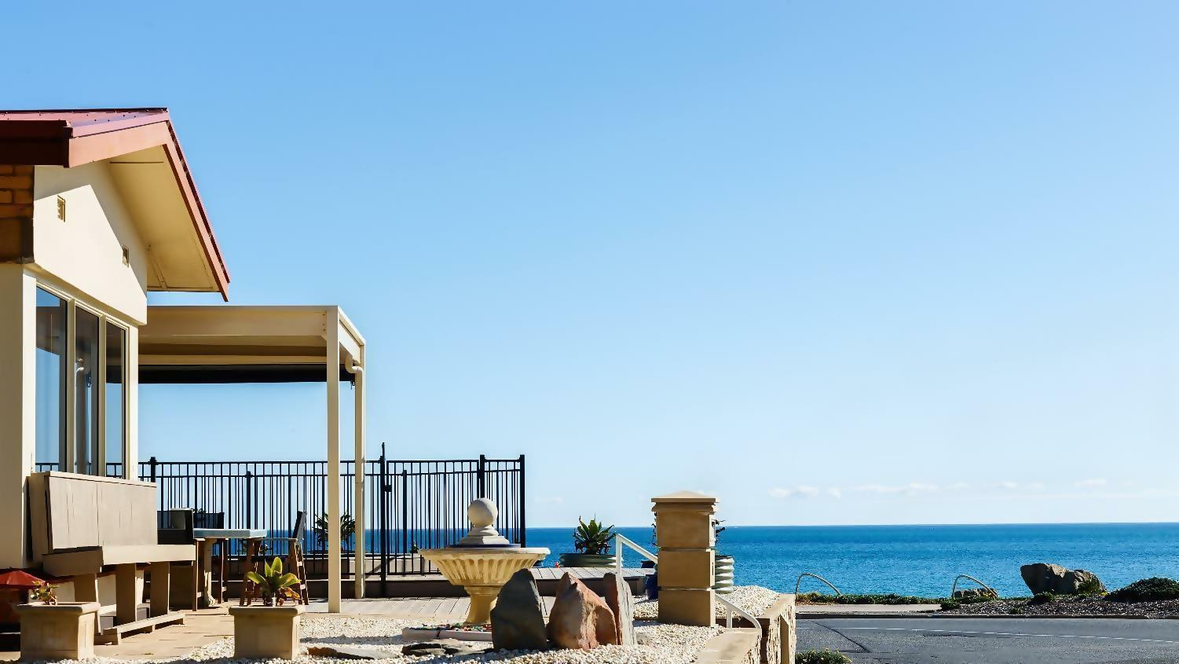
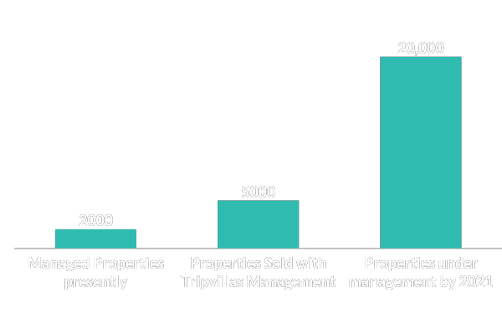
About Tripvillas
The leading manager of resort communities. Founded in 2011 by Mr. Roshan Dsilva in Singapore. Shareholders include Singapore Prime Minister’s Office and Others (28%).
Over 50,000 Holiday homes rented across Asia - World’s 3rd largest player. In 2017, began the Management Model.
Over 2000 properties under management and another 8000 sold with Tripvillas management and handover by 2023.
100% owned subsidiaries in India, USA. Over 70 Authorized agents and 60,000+ empaneled travel agencies.
Proprietary Information © Tripvillas 2019

Slide 42











OUR AGENTS - OVER 70+ ACROSS THE GLOBE

Slide 43
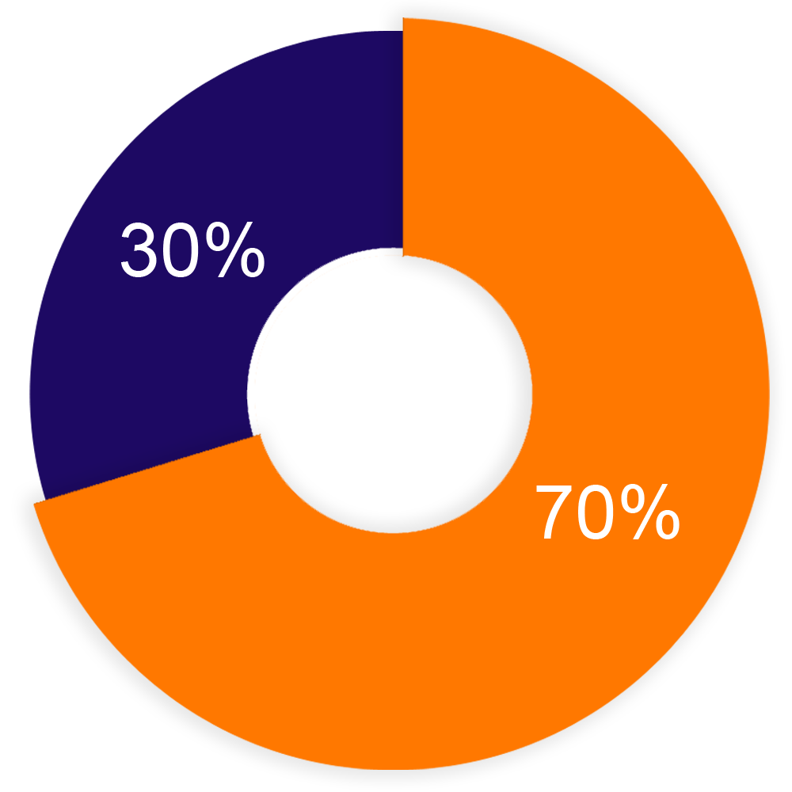

RENTAL PROGRAME
Owners have no restrictions on use by them or their family members.
Option to opt for rental pool model or else individual model.
Can self - furnish and submit for inspection by Tripvillas onsite team or else opt for Tripvillas designed furniture package.
Revenue sharing of 70:30 - with 70% going to the owner of the property and 30% to Tripvillas.
All ongoing costs within the property apart from society maintenance and property taxes are borne by Tripvillas from it’s 30% share.
These include - Marketing, Commissions to OTAs, Housekeeping, Internet, Cable bills, electricity bills, Laundry and Consumables.
Tripvillas provides full transparency and real time booking and customer service through owner apps, dashboard etc.
30 days free stay for the owner in the 11 month contact
APT. OWNER
Proprietary Information © Tripvillas 2019

Slide 44
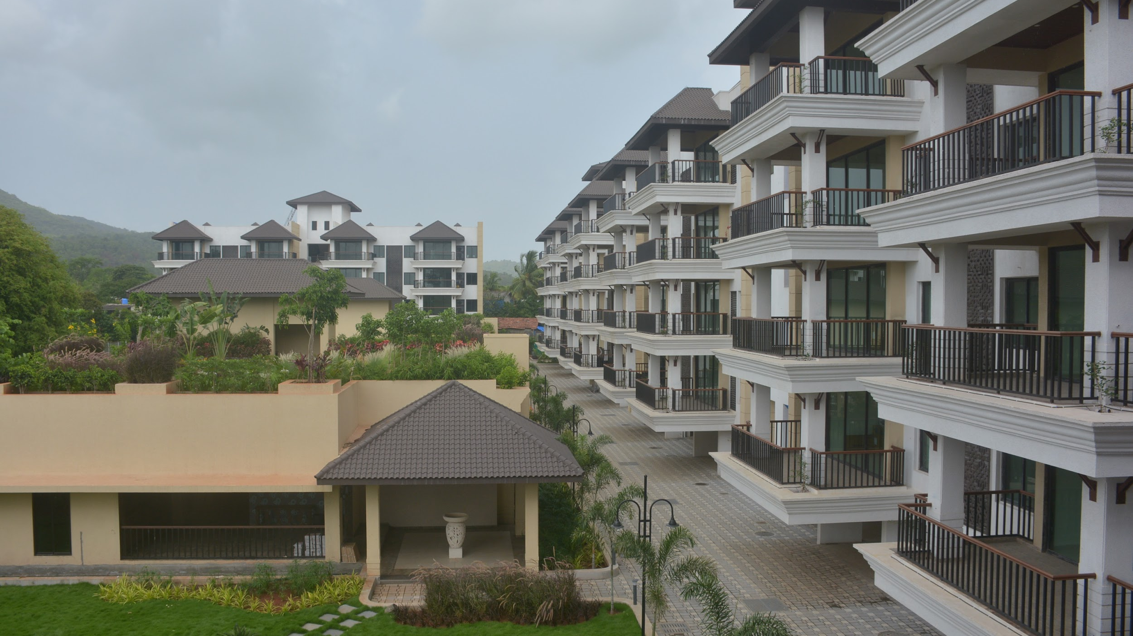
Decision 1: Furnishing your property
Option 1:- Self Furnish
Owners Take Possession, Self Furnish their property and then submit for Inspection to Tripvillas On site team who will then assess the property and allot it a nightly rate.
Option 2:- Ikea Furniture Package
Owners opt-in for Tripvillas designed IKEA Furniture package and those apartments will be furnished under the supervision of Tripvillas.
Proprietary Information © Tripvillas 2019

Slide 45



GREEN INITIATIVE
2 - SEWAGE TREATMENT PLANT
RAIN WATER HARVESTING
SOLID WASTE MANAGEMENT

Slide 46







OUR HOME LOAN PARTNERS

Slide 47
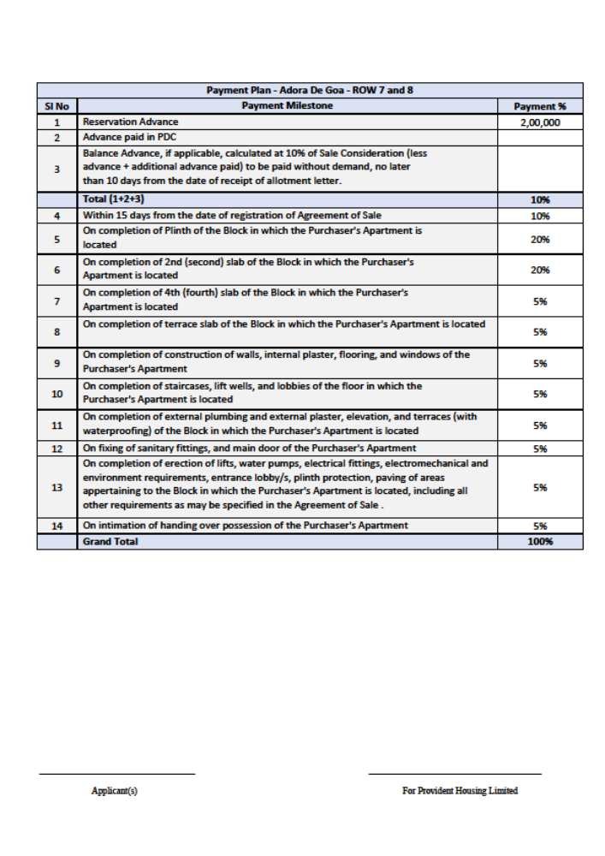

Slide 48
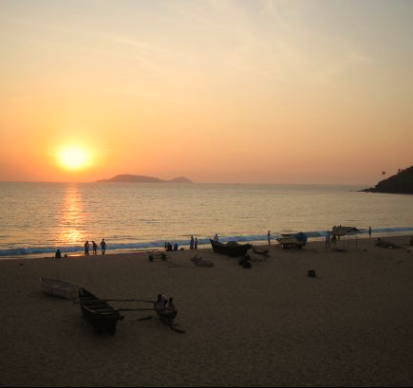
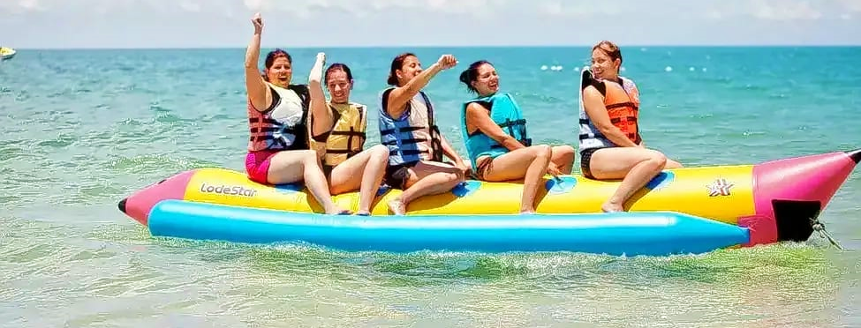
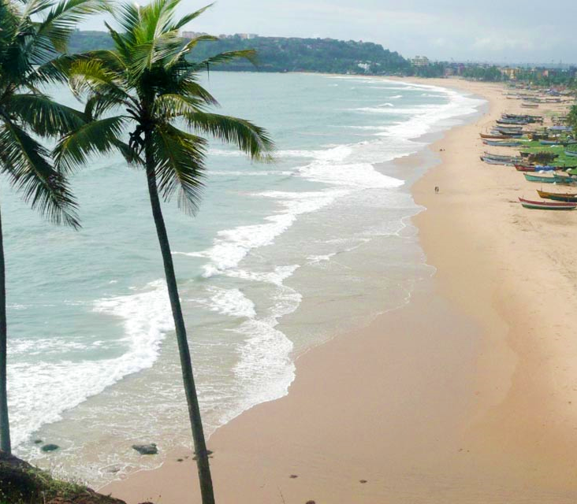
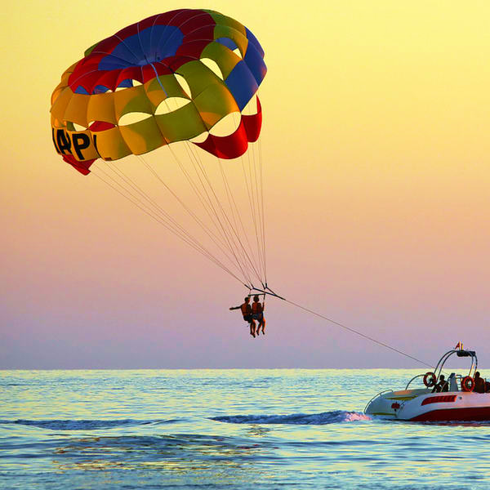

BOGMALO BEACH – 4KM
BAINA BEACH - 7 KM

Slide 49
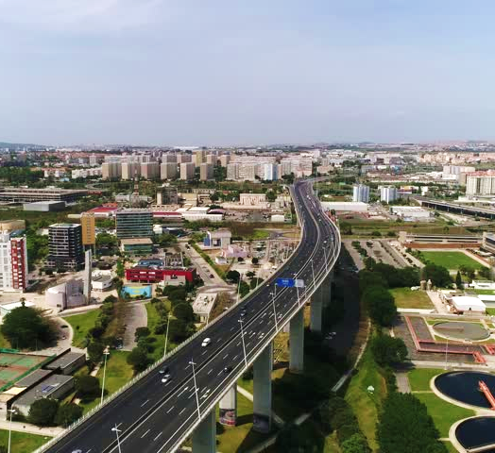
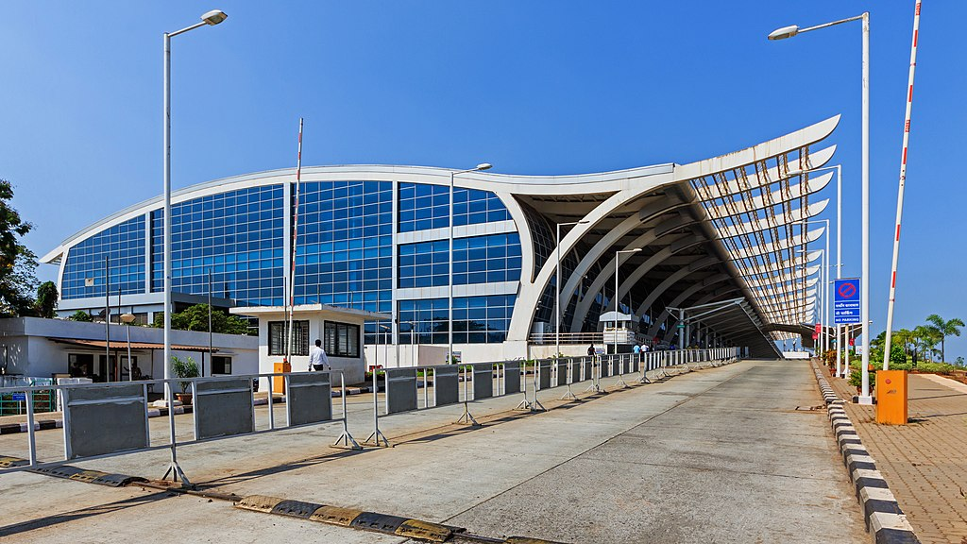

GOA INTERNATIONAL AIRPORT 4 KM
VASCO CITY – 7KM

Slide 50



SMRC`s V.M. SALGAOCAR
HOSPITAL
5 km
College’s
BITS PILANI – 2km
M.E.S college – 200 mtrs
Schools
MOUNT LITERA – 3km
NAVY – 3km
KENDRA VIDHYALAYA – 5km

Slide 51

DRONE SHOTS OF NOVEMBER
Airport Runway

Slide 52


BLU
MIXED BLOCK

Slide 53


Slide 54


Slide 55

8
9
7
5
6
10

Slide 56


PRICING & POSSESSION DATES
MARCH 2023 [10,11,12,17 & 18] MARCH 2024 – [13,14,15,16 & MB | 2,3,4,5, & 6] Dec 2025 – [ 7 & 8 ]
East Pointe & Park Residences
East Pointe & Park Residences
| West Pointe & Balinese
Aroha Goa

